Slide 1
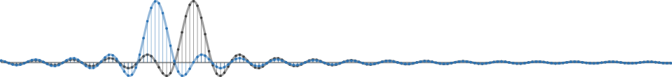
GNU Radio Basics & Interfacing to Aselsan COMINT Receivers
Murat Sever
Kasım, 2018

Slide 2
Outline
GNU Radio 101
GNU Radio Interface to Aselsan COMINT Receivers
GNU Radio Live Demos
Future Work

Slide 3

GNU Radio is…
A signal processing library
Designed for real-time
The software part of an SDR
Not a radio application
The tool to build your own transceivers
FOSS: Free and Open Source Software

Slide 4
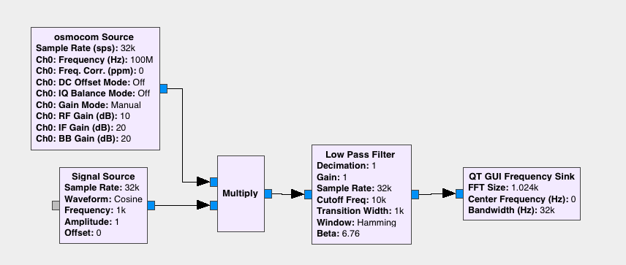
Basic Concept: Flow Graph
Transceivers are implemented as flow graphs
Similar to Simulink / schematics
Define structure and parameters of blocks

Slide 5
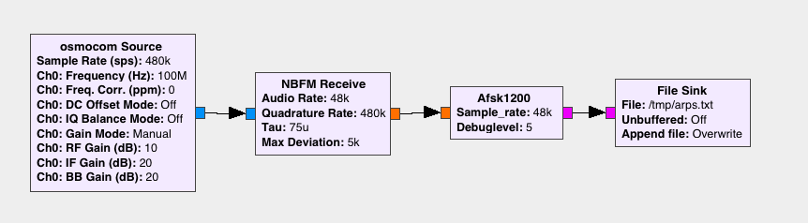
Basic Concept: Block
Written in C++ or Python
Implement one logical step
Each block run in separate thread
Can be encapsulated into hierarchical blocks

Slide 6
Data Streams
Samples are buffered
Data types are color-coded
Complex
Float
Byte

Slide 7
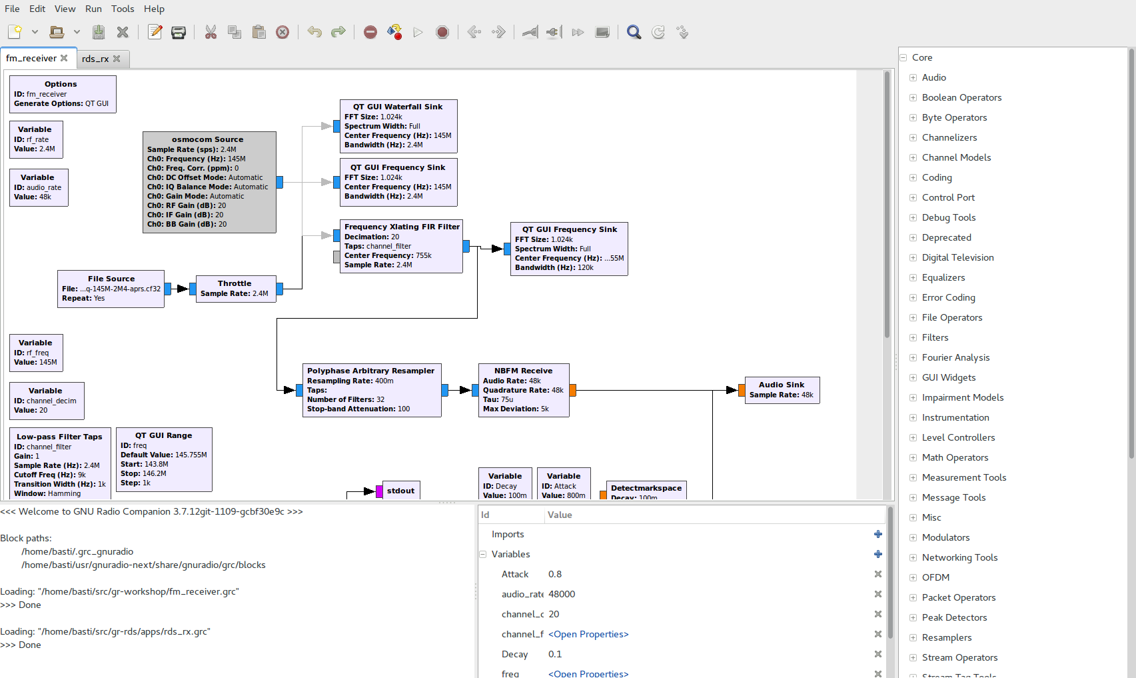
GNU Radio Companion
Block Library
Edit Flowgraph
Console
Variables

Slide 8
GUI Output and Instrumentation

Slide 9
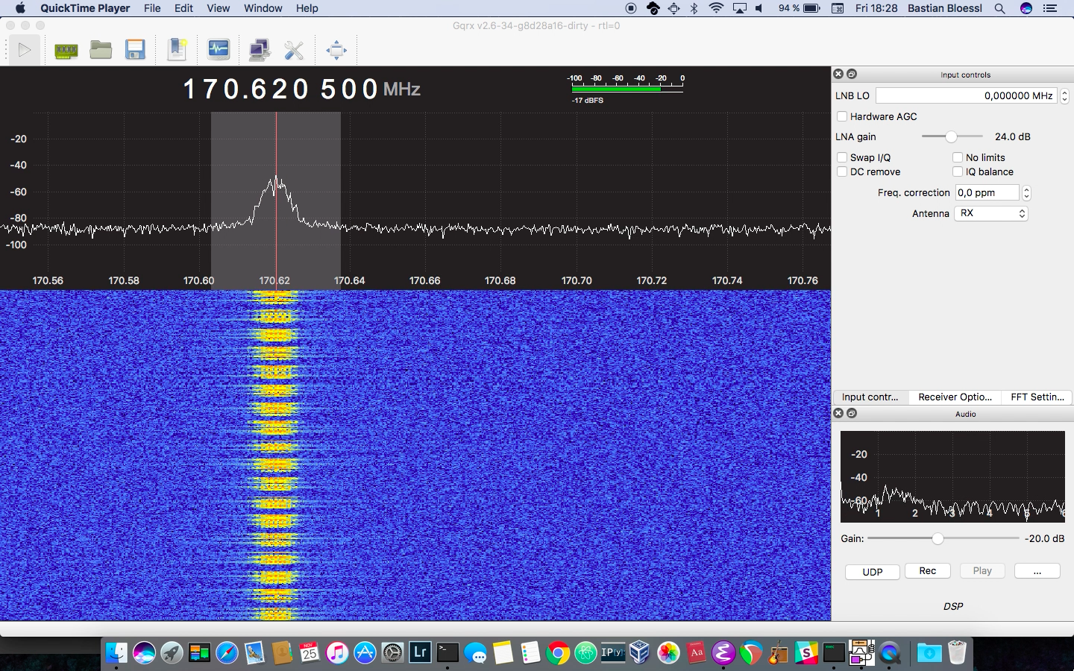
GQRX - a GNU Radio Application

Slide 10
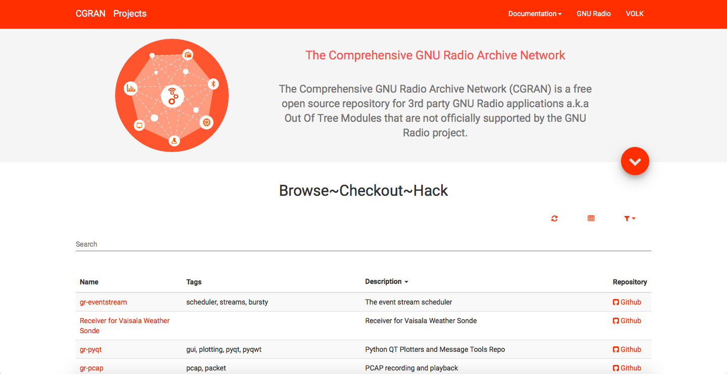
Out Of Tree Modules
GNU Radio can be extended with OOTs
OOTs cover more specific functionality
There is a large number available
CGRAN is our central database

Slide 11

GNU Radio is used by
Commercial
R&D
Defense
Research
Infosec
Research
Academic
Research
Hardware
Vendors
Professional
Service
Providers
Students
Hobbyists

Slide 12
GNU Radio is an Ecosystem
Active Open Source community since 2001
PyBombs, OOTs
GRCon since 2011
GNU Radio Foundation
FOSDEM SDR DevRoom
GSoC, SoCIS, R&S Competition, SDR Academy
GNU Radio Europe

Slide 13
Installing GNU Radio
From source: GitHub
Package manager
Some are pretty outdated
macOS / homebrew
PyBombs: integrated dependency management and 3rd party application installation

Slide 14
Learn // Discuss // Connect
Website: www.gnuradio.org
Development: github.com/gnuradio
Mailing List: discuss-gnuradio@gnu.org
Wiki: wiki.gnuradio.org
Slack: slack.gnuradio.org
Facebook: gnuradioproject
Twitter: @gnuradio

Slide 15
It all began…
New hardware access library written for HF-ED Project
No working GUI available at that time
Need to verify FFT and IQ data
Make sure receiver is configured right
center frequency, bandwidth…
Visualize data

Slide 16
GNU Radio Interface to Aselsan Comint Receivers
Aselsan Comint Receivers
Two main data streams
FFT: Upon request
IQ: Continuous
They are both in
Complex
Int32
Big Endian
Split form (like IIII…IQQQ…Q)
GNU Radio expects in complex, float32 and interleaved ☹

Slide 17
GNU Radio Demo: FFT
Receiver tuned to 10MHz center frequency, 25k bandwidth
440Hz AM modulated signal is supplied by signal generator
We request 1024-pt FFT every second

Slide 18
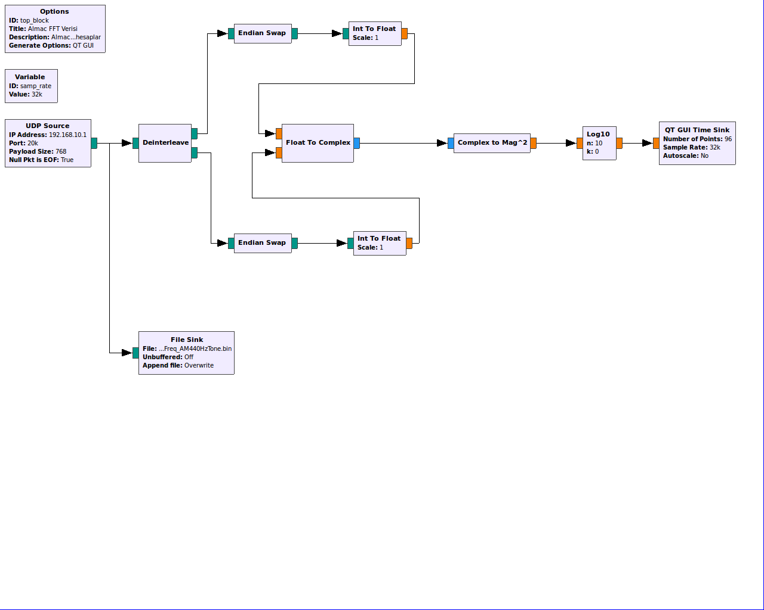
GNU Radio FFT
DSP
Visual
Conversion
Replay&Analysis
DEMO

Slide 19
GNU Radio Demo: IQ
Receiver tuned to 10MHz center frequency, 25k bandwidth
We receive continuous IQ data and calculate and display real-time 1024-pt FFT
Records given to System Eng. for offline analysis

Slide 20
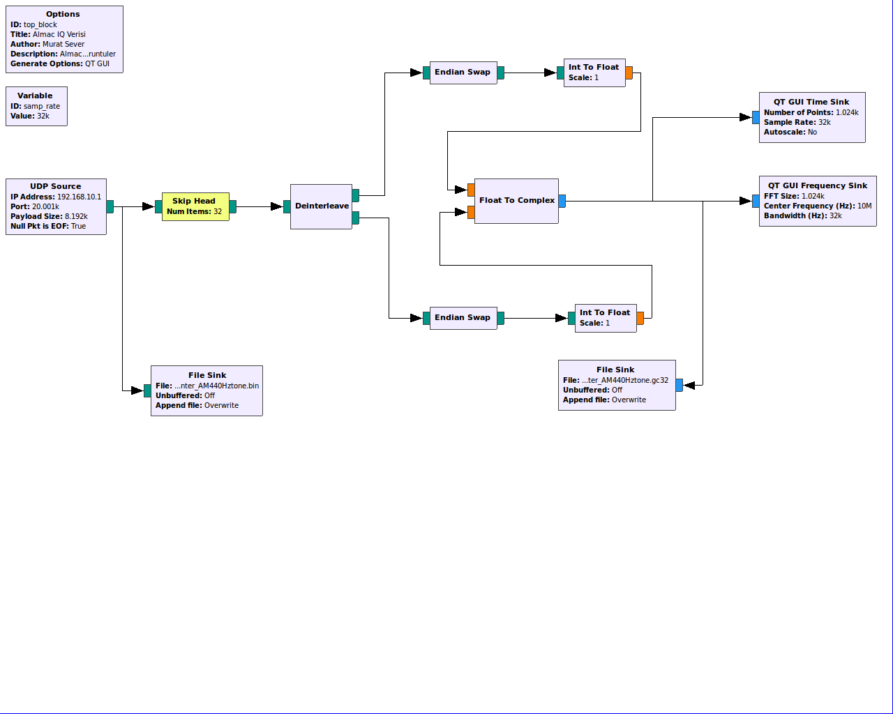
GNU Radio IQ
Conversion
Visual
Replay&Analysis
Replay&Analysis
DEMO

Slide 21
Later demod blocks have arrived…
Later, demod blocks have been added to the Project
Still need to verify they work as expected
But again no GUI or player available to listen to the digital audio stream (DAUD)
GNU radio to the rescue ☺

Slide 22
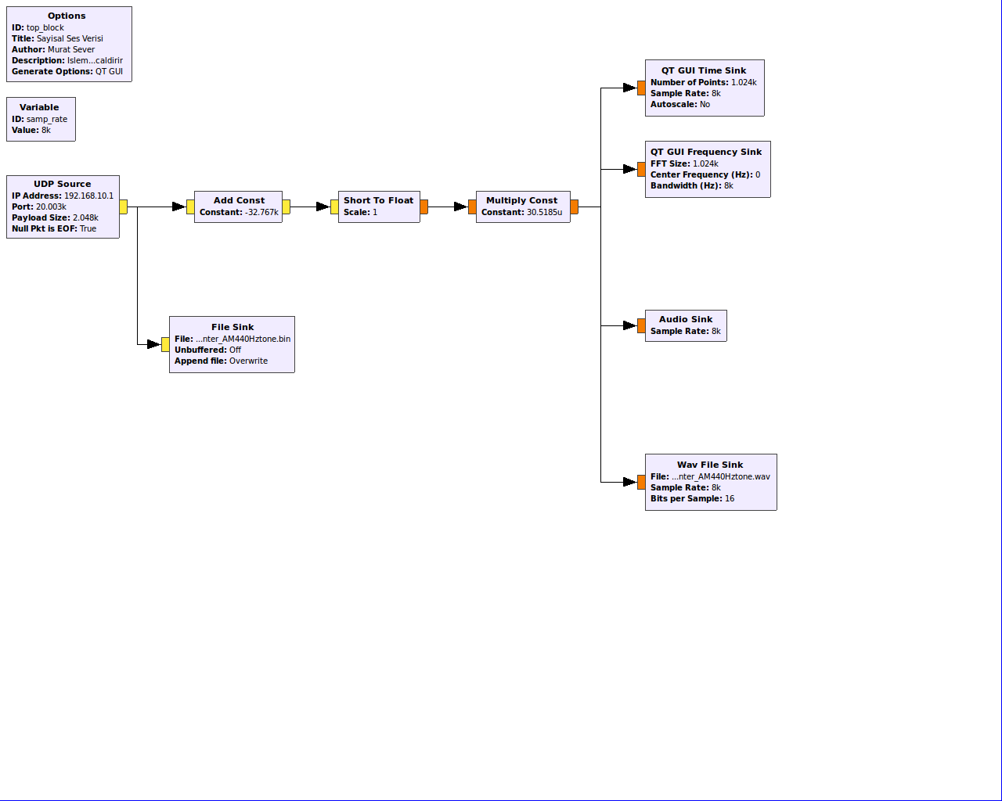
GNU Radio DAUD
Conversion
Visual
Audio
Replay&Analysis
Replay&Analysis
Replay&Analysis
DEMO

Slide 23
Future Work
Aselsan Source block need to be written
Multi-channel data can be received
Phase measurements can be made online
Easy data recording
All COMINT algorithms can be implemented and prototyped
Digital demodulation blocks ready to use
Key to other FOSS apps
Inspectrum, gr-inspector, …

Slide 24
Thanks

